Slide 1
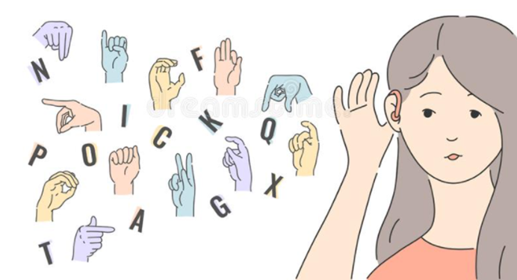
CONVERSATION ENGINE FOR DEAF AND DUMB USING IBM WATSON
TEAM PERCEPTRON :
Ashish Maan
Hemang Maan
Kanchan Sanjay Joshi
Devika Srivastava
Akanksha Sharma
VIT - 004

Slide 2
INTRODUCTION :
Sign language is used as a communication medium between deaf and dumb to convey infromation to one other.
In order to bridge the gap in communication among the deaf,dumb and normal community, we have prepared a model which uses HGRVC (Hand Gesture Recognition and Voice Conversion) This system localizes and track the hand gestures of the deaf and dumb so that normal people can easily understand the meaning of the various gestures which are used in sign language.
This method gives output in text format that helps to reduce the communication gap between deaf & dumb people.

Slide 3
LITERATURE SURVEY
EXISTING PROBLEM :
Different approaches are employed by completely different researchers for recognition of varied hand gestures that were enforced in numerous fields. The total approaches can be divided into 3 broad classes Hand segmentation approaches Feature extraction approaches and Gesture recognition approaches.
PROPOSED SOLUTION :
In order to bridge the gap in communication among deaf, dumb community and normal community, lot of research work has been carried out to automate the process of sign language interpretation with the help of image processing and pattern recognition techniques.

Slide 4
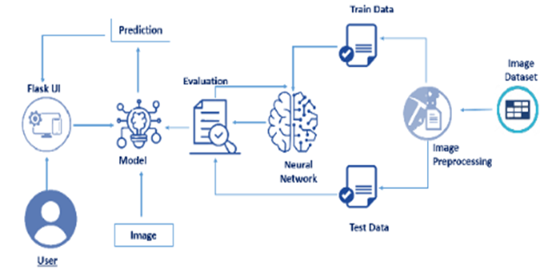
BLOCK DIAGRAM

Slide 5
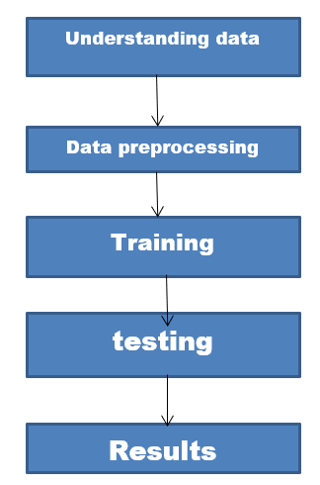
FLOW CHART :

Slide 6
SOFTWARES USED :
To complete this project , the following softwares were used :
Anaconda (IDLE / Spyder / PyCharm)(Python 3.7)
Python Packages
Tensorflow:- This package is used as backend support to Keras
Keras:- This package is used for building Neural Network layers
OpenCV:- This package is used for image processing
Flask:- To build a web application to show output.

Slide 7
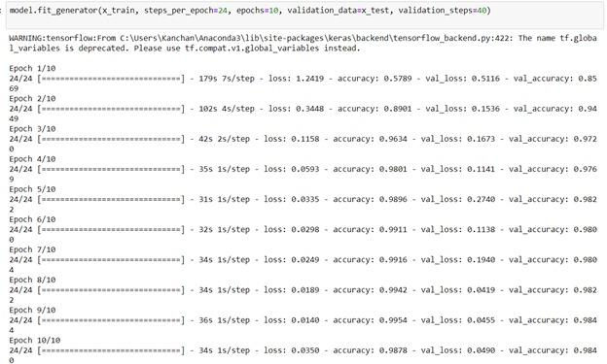
EXPERIMENTAL TRAINING
TESTING RESULT :
We are getting accuracy of 98 percent with minimal loss.

Slide 8
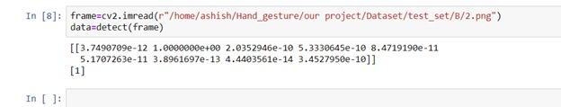
TESTING RESULT :
The image passed by us (image of B) is being correctly detected (index of B =1) by the system.

Slide 9
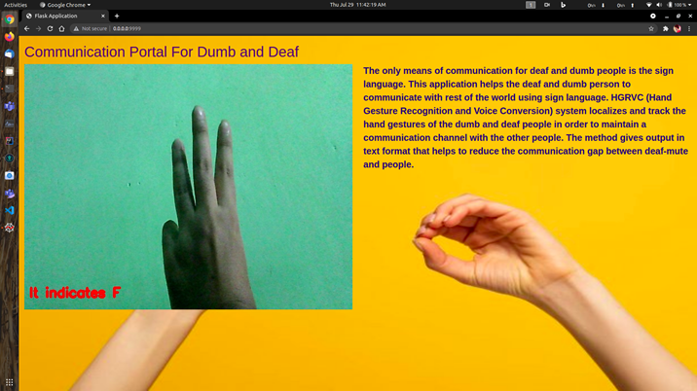
RESULT :
This is the final output of our flask application.

Slide 10
ADVANTAGES AND DISADVANTAGES :
ADVANTAGES:
It provides an environment for the user to send message through a sign language. It recognizes the hand gestures of sign language through image processing.
Other feature converts the speech spoken into text.
DISADVANTAGES:
It has limitations such as it cannot convert text to speech now but it can be upgraded.

Slide 11
APPLICATIONS:
To cater the needs of children who are non-verbal or are having speech problems.
The app comes to the aid of mute, deaf and other non-verbal users when having a conversation with other people
CONCLUSION:
Using this model we built it will greatly help the deaf and dumb people as it convert sign language into text. It will improve the communication between them.

Slide 12
LEARNING EXPERIENCES :
As a team, we learnt
How an app is built using flask and integrate with html page.
How to train a model on IBM Watson.
How train and test is done using jupyter notebook.
Working of Spyder.

Slide 13
FUTURE SCOPE :
Lot of developments can be made in the application such as:-
Adding feature like converting text to speech.
We can also create a mobile app for the same.
We can add more dataset so efficiency of model will greatly increase.

Slide 14


